Slide 1


-SATHVIKA BANDI (231EC150)
-ASRITH SINGAMPALLI (231EC110)
Verilog-Based CNN Accelerator on FPGA:CIFAR 10
Guided by: Sushil Kumar Pandey
1

Slide 2

Introduction
Deep learning models, especially CNNs, require significant computational power, making software-based implementations on CPUs and GPUs inefficient for real-time applications.
To address this, our project develops a Verilog-based CNN accelerator for CIFAR-10 image classification, optimizing convolutional layers, neuron modules, and weight storage for high-speed and paralell processing
2

Slide 3
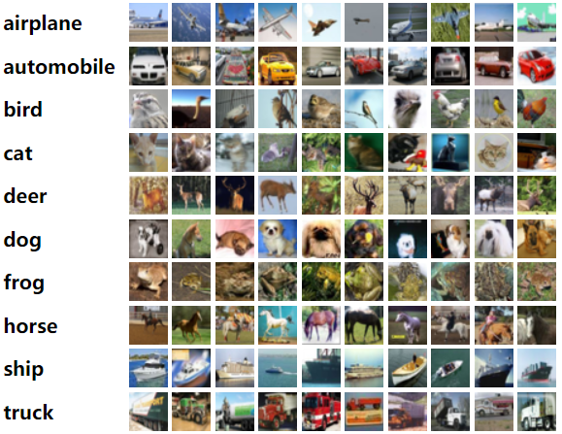
Problem Statement
To develop a Verilog-based deep learning accelerator that enables real-time,high speed CIFAR-10 image classification by optimizing convolutional layers, neuron processing, and weight storage through hardware parallelism and pipelining.
3

Slide 4

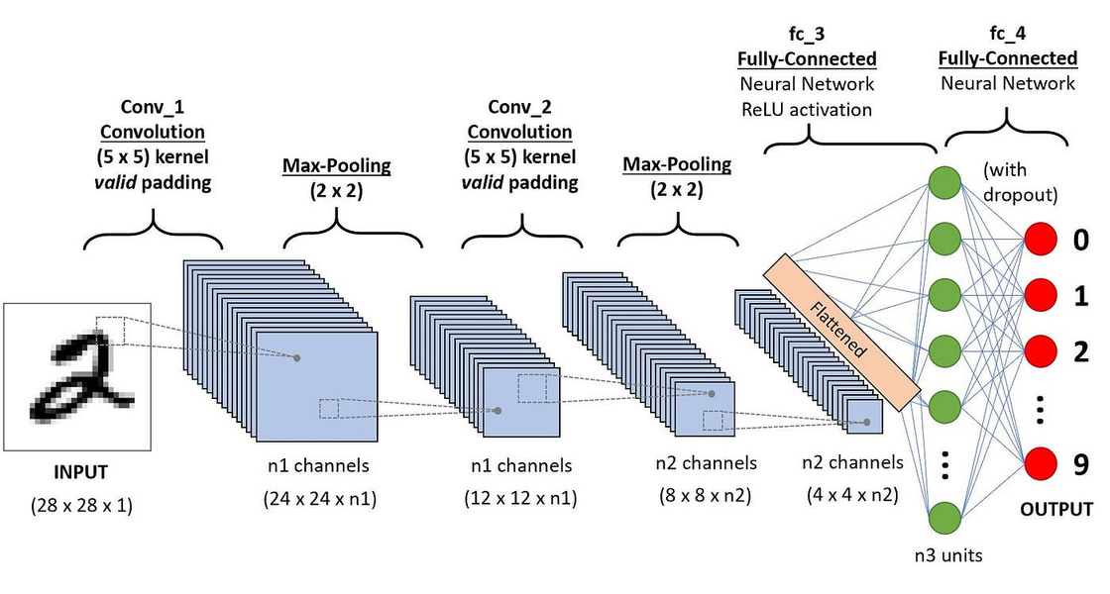
Objectives
Design and implement a reliable and efficient Verilog-based deep learning accelerator for CIFAR-10 image classification.
Ensure high-speed, inference with optimized convolutional, activation, and pooling layers.
Optimize memory usage and weight storage to support efficient computations.
Address factors such as real-time performance, low power and hardware limitations.
Explore potential enhancements and scalability for broader deep learning applications.
4
Convolution Neural Network (CNN) – Fundamental of Deep Learning

Slide 5

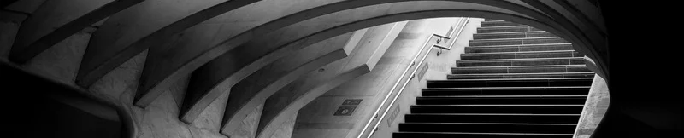
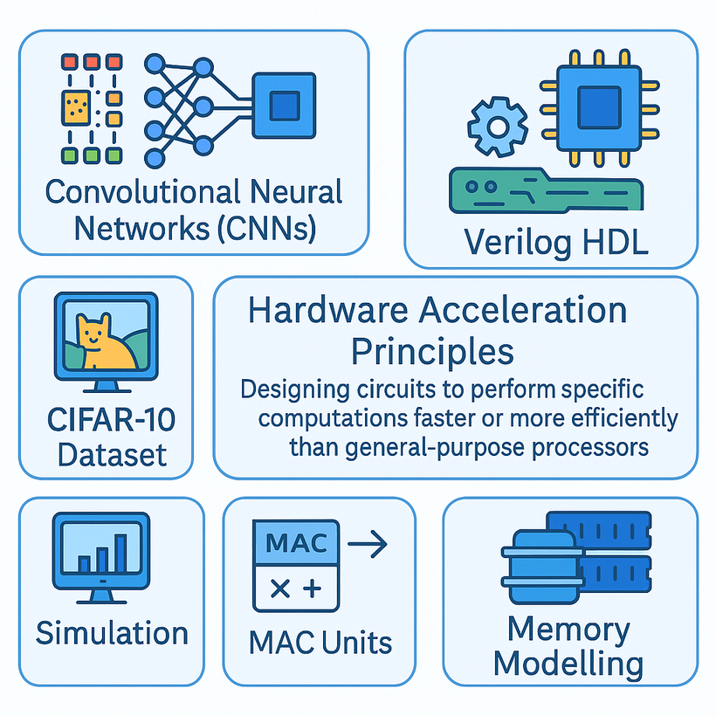
Key Concepts
Convolutional Neural Networks (CNNs): Verilog HDL Hardware Acceleration Principles: Designing circuits to perform specific computations faster or more efficiently than general-purpose processors. CIFAR-10 Dataset Simulation Paralellism and Pipelining Fixed-Point Arithmetic MAC Units Memory Modelling
Our Mission and Vision | 4
Our Goals | 5
Our Traction | 6
Our Market | 7
5

Slide 6

Methodology
Research & Requirement Analysis: Study CNNs, Verilog design principles, CIFAR-10 task. Define accelerator architecture.
Neural Network Architecture Design: Plan Verilog module hierarchy: neurons, layers, memory interfaces, activation logic, and convolution units.
Pretrain weights
Verilog Implementation: Write Verilog code for all modules (Convolution, FC, Pooling, etc.).
Testing with Dataset: Use (pre-processed) CIFAR-10 data vectors in testbenches t
Final Evaluation on FPGA & Documentation: Implementing on FPGA .Analyze simulation results.
6
Notes:
The convolutional and fully connected layer weights were pretrained using Python on the CIFAR-10 dataset. The learned weights were extracted and converted into fixed-point (16-bit) format suitable for hardware implementation.

Slide 7
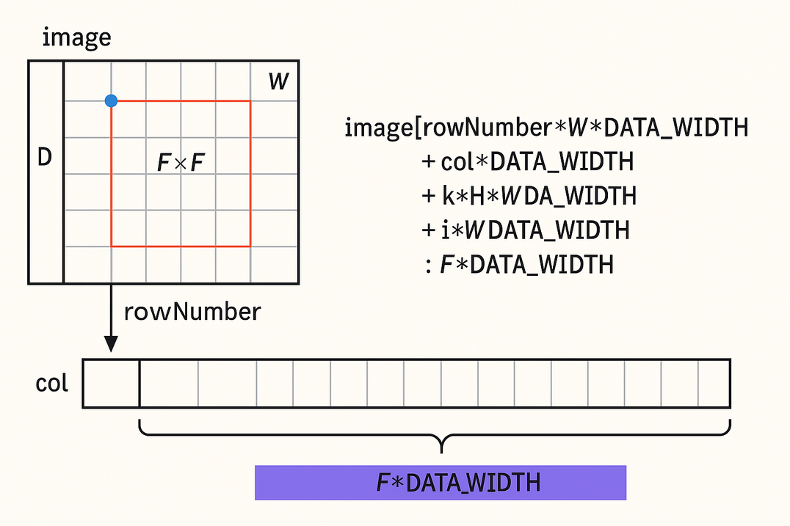
Design and Implementation
Design and Implementation
1. Input Layer:
Input Size: 1x32x32
The CIFAR-10 images (originally 3×32×32) were converted to grayscale to simplify processing and hardware complexity.
2. First Convolution Layer:
Output: 6x28x28
Applies 6 filters of size 5×5 with stride 1 and no padding.
Output size reduces from 32x32 → 28x28 because:
Output size=32−5+1=28\text{Output size} = 32 - 5 + 1 = 28Output size=32−5+1=28
Receptive Field: Each neuron in this layer looks at a 5×5 region of the input image.
7

Slide 8
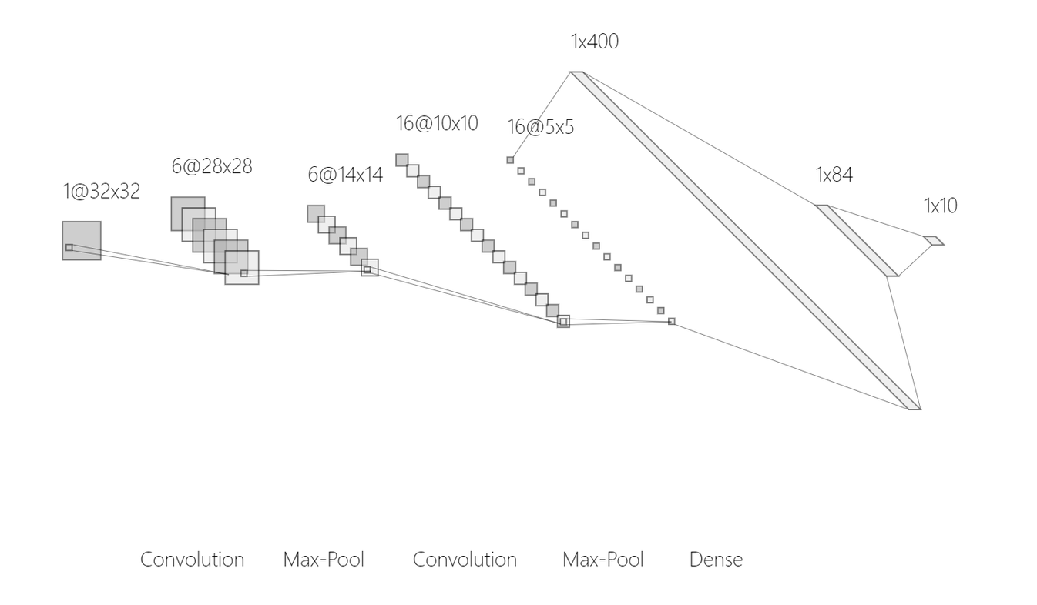
3. First Max-Pooling Layer:
Output: 6x14x14
Applies 2×2 max-pooling with stride 2.
Downsamples each feature map by a factor of 2:
28/2=14
5. Second Max-Pooling Layer:
Output: 16x5x5
Again uses 2×2 max-pooling with stride 2.
Output size becomes:
10/2=5
4. Second Convolution Layer:
Output: 16x10x10
Applies 16 filters of size 5×5 over the 6 pooled feature maps.
Output reduces:
14−5+1=10
The number of channels increases to 16.
8

Slide 9
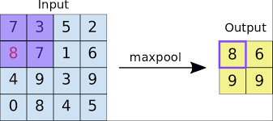
6. Flatten Layer:
Output: 1×400
The 16 feature maps of size 5x5 are flattened into a 1D vector of 400 values:
16×5×5=400
7. Fully Connected (Dense) Layers:
First Dense Layer:
Input: 1×400
Output: 1×84
Connects all 400 inputs to 84 neurons using standard matrix multiplication.
Second Dense Layer (Output Layer):
Input: 1×84
Output: 1×10
Maps to 10 classes of CIFAR-10.
Likely uses softmax activation for producing class probabilities.
Max Pooling Layer | NumPyNet
9

Slide 10
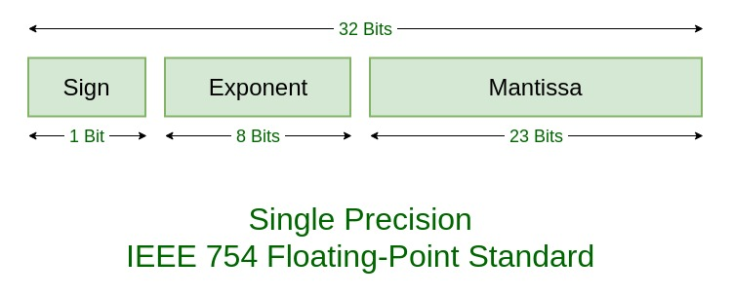
8.Implementation and Bitstream Generation
Map your design onto the FPGA fabric.
Generate the bitstream file (.bit) to program the FPGA.
9. On-Board Testing
Hardcoded the input image in the top module. The FPGA board displays the number of the classified image on the 7-segment display.
Verify real-time output.
Measured:
Inference latency=1.5ms
Accuracy match with software model
IEEE Standard 754 Floating Point Numbers | GeeksforGeeks
10

Slide 11
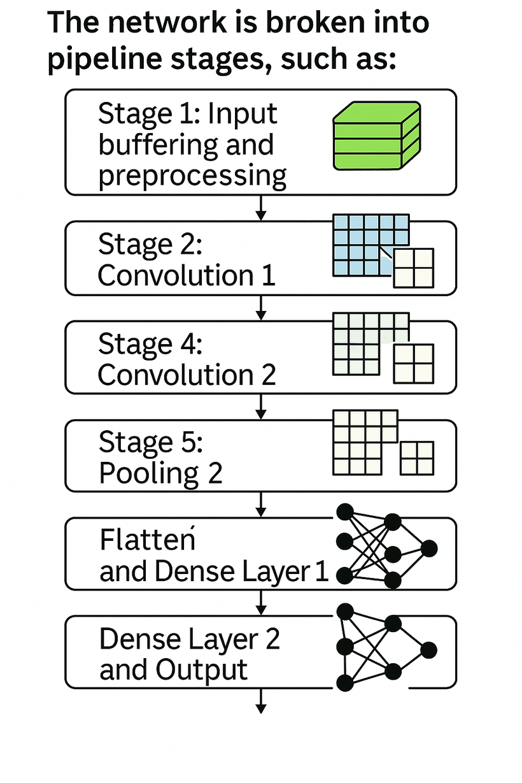
Pipelining and Paralellism
1. Layer-Level Pipelining
Each layer operates independently with input/output buffers, enabling simultaneous execution across layers.
2. Stage Separation
Distinct functional stages minimize interference time.
1. Parallel Convolution Operations
Multiple filters are applied in parallel using dedicated MAC units.
2. Parallel Pixel Processing Within a Kernel
Pixels within a feature map region are processed concurrently.
3. Parallel Pooling
Pooling operations are performed in parallel.
11
Notes:
The network is broken into pipeline stages, such as:
Stage 1: Input buffering and preprocessing
Stage 2: Convolution 1
Stage 3: Pooling 1
Stage 4: Convolution 2
Stage 5: Pooling 2
Stage 6: Flatten and Dense Layer 1
Stage 7: Dense Layer 2 and Output

Slide 12
Outcomes
1
2
3
4
A complete, functionally verified Verilog codebase for a CNN accelerator targeting CIFAR-10.
Successful simulation demonstrating correct classification behavior for test vectors.
The verified Verilog design serves as a foundation for potential future FPGA synthesis.
Implemented on FPGA and checking for correctness and Analysis of simulated performance metrics
12

Slide 13
Literature Review
Kumar & Madhumati (2023): Designed a CNN architecture for object detection on FPGA, emphasizing efficient integration of convolutional and pooling layers to balance performance and resource utilization.
Yan et al. (2023): Focused on the design and implementation challenges of mapping CNN architectures onto FPGA hardware, providing solutions for efficient deployment.
Nielsen (2019): Provided foundational concepts in neural networks and deep learning, offering essential insights into CNN structures and operations.
13

Slide 14
References
Kumar, N. S., & Madhumati, G. L. (2023). Implementation of Convolutional Neural Networks on FPGA for Object Detection. *2023 14th International Conference on Computing Communication and Networking Technologies (ICCCNT)*. doi:10.1109/ICCCNT56998.2023.10307606. (Relevant for CNN architecture ideas)
Hailesellasie, M., Hasan, S. R., Khalid, F., Wad, F. A., & Shafique, M. (2018). FPGA-Based Convolutional Neural Network Architecture with Reduced Parameter Requirements. *2018 IEEE International Symposium on Circuits and Systems (ISCAS)*. doi:10.1109/ISCAS.2018.8351283. (Relevant for optimization ideas)
Yan, R., Yi, J., He, J., & Zhao, Y. (2023). FPGA-based Convolutional Neural Network Design and Implementation. *2023 3rd Asia-Pacific Conference on Communications Technology and Computer Science (ACCTCS)*. doi:10.1109/ACCTCS58815.2023.00058. (Relevant for design) Nielsen, M. (2019). *Neural Networks and Deep Learning*. Determination Press. (http://neuralnetworksanddeeplearning.com/) (Fundamental CNN concepts)
14

